Slide 1
Geomorphology, Neotectonics, and Hazards in the Sierra Nombre de Dios Region of Honduras
Michael Bierwagen (Undergraduate Student, Presenter)
Kelin Whipple Ph.D. (Mentor)
Mathew Rossi (Graduate Student)
Arizona State University
School of Earth and Space Exploration

Slide 2
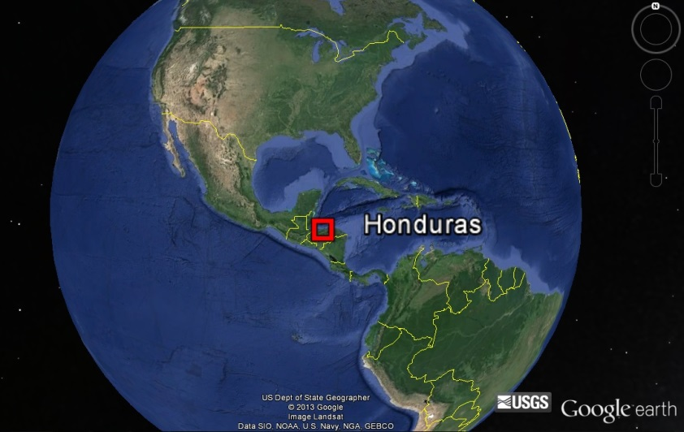
BACKGROUND
The Nombre de Dios mountain range poses significant hazard to the city of La Ceiba, the fourth largest city in the nation of Honduras, including hazards from landslides, earthquakes, and flooding.
La Ceiba
northern coast of Honduras
over 195,000 residents
Cangrejal River runs through the city
Sierra Nombre de Dios
steep, rising abruptly (high uplift rate)
located close to transform tectonic plate margin
faults extend across the Sierra Nombre de Dios parallel to the plate margin
a network of rivers descends from the mountains north and flows directly into the Atlantic Ocean
Image Courtesy: Google

Slide 3
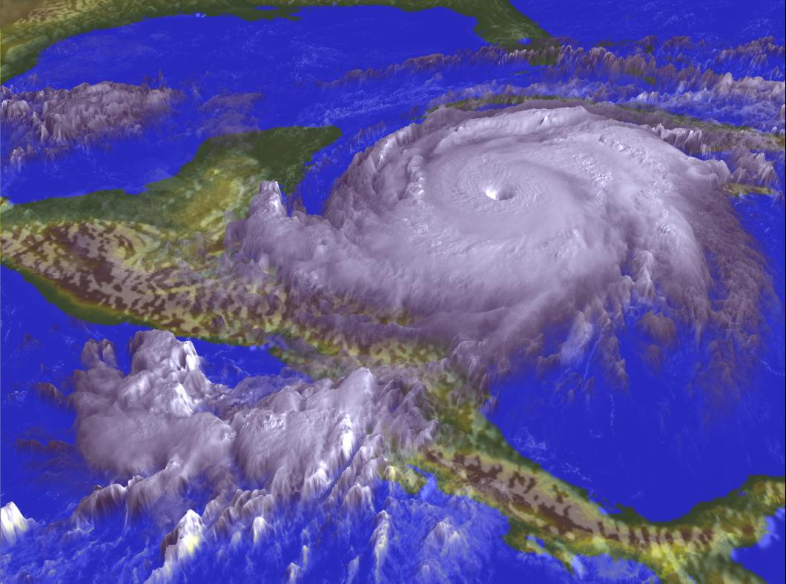
Hurricane Mitch – October 1998
In the fall of 1998, Hurricane Mitch devastated Honduras including the city of La Ceiba.
In Honduras alone, Hurricane Mitch:
killed over 7,000 people
resulted in over 3 billion USD damage
resulted in widespread flooding, including in La Ceiba
Image Courtesy: NASA RSD

Slide 4
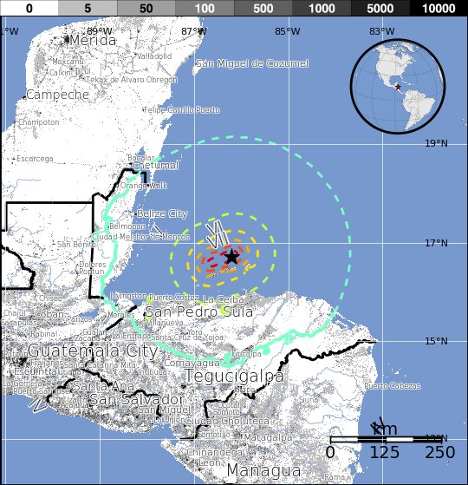
M7.3 Earthquake North of Honduras
M 7.3 - Offshore North Honduras
May 28th 2009 08:24:45 UTC
In northern Honduras at least:
7 people killed
40 injured
130 buildings damaged or destroyed
The central span of a major bridge at
El Progreso, Honduras was destroyed.
This earthquake demonstrated that this
plate boundary is capable of producing
at least Magnitude 7.3 earthquakes.
Image Courtesy: USGS Earthquake Hazards Program

Slide 5
PROJECT
Project Focus:
Constructing bilingual (English and Spanish) educational maps as an outreach tool to be utilized by “The Lodge at Pico Bonito” ecotourism lodge located in the region.
The map set will be designed to educate locals and visitors of the geologic and natural hazards (seismic, flooding, and landslide hazards) of the region.
The finished map set will contain several maps including:
a regional map showing the plate tectonics and seismicity of the North American/Caribbean plate boundary
a neotectonic map illustrating uplift patterns and active faults in Sierra Nombre de Dios
a geomorphic map highlighting faults and alluvial fans in the near vicinity of the ecolodge

Slide 6
METHODS
The project is utilizing GIS software to construct the maps in conjunction with seismological data as well as NASA products including:
TRMM (Tropical Rainfall Measuring Mission) data
SRTM (Shuttle Radar Topography Mission) data
ASTER (Advanced Spaceborne Thermal Emission and Reflection Radiometer) data

Slide 7
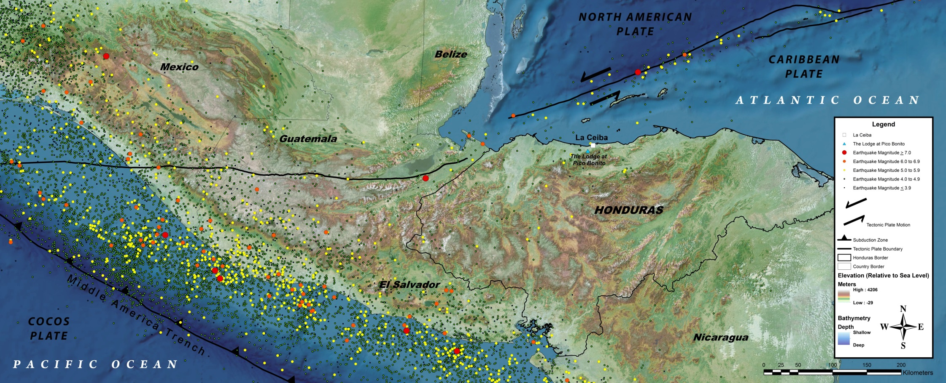
Regional Tectonic Map with Seismicity Since 1962
*Preliminary Map
This map will illustrate the large scale tectonic setting and seismicity of the region.
La Ceiba is located near a left-lateral transtensional plate boundary between the North American Plate and the Caribbean Plate. In this region the plate boundary accommodates about 20 mm/y slip.
Large scale faults in the Nombre de Dios mountain range run parallel to this plate boundary. The lack of recent earthquakes near La Ceiba associated with these faults in the mountain range could result in a potential large earthquake in the future from a large build-up of energy over time.

Slide 8
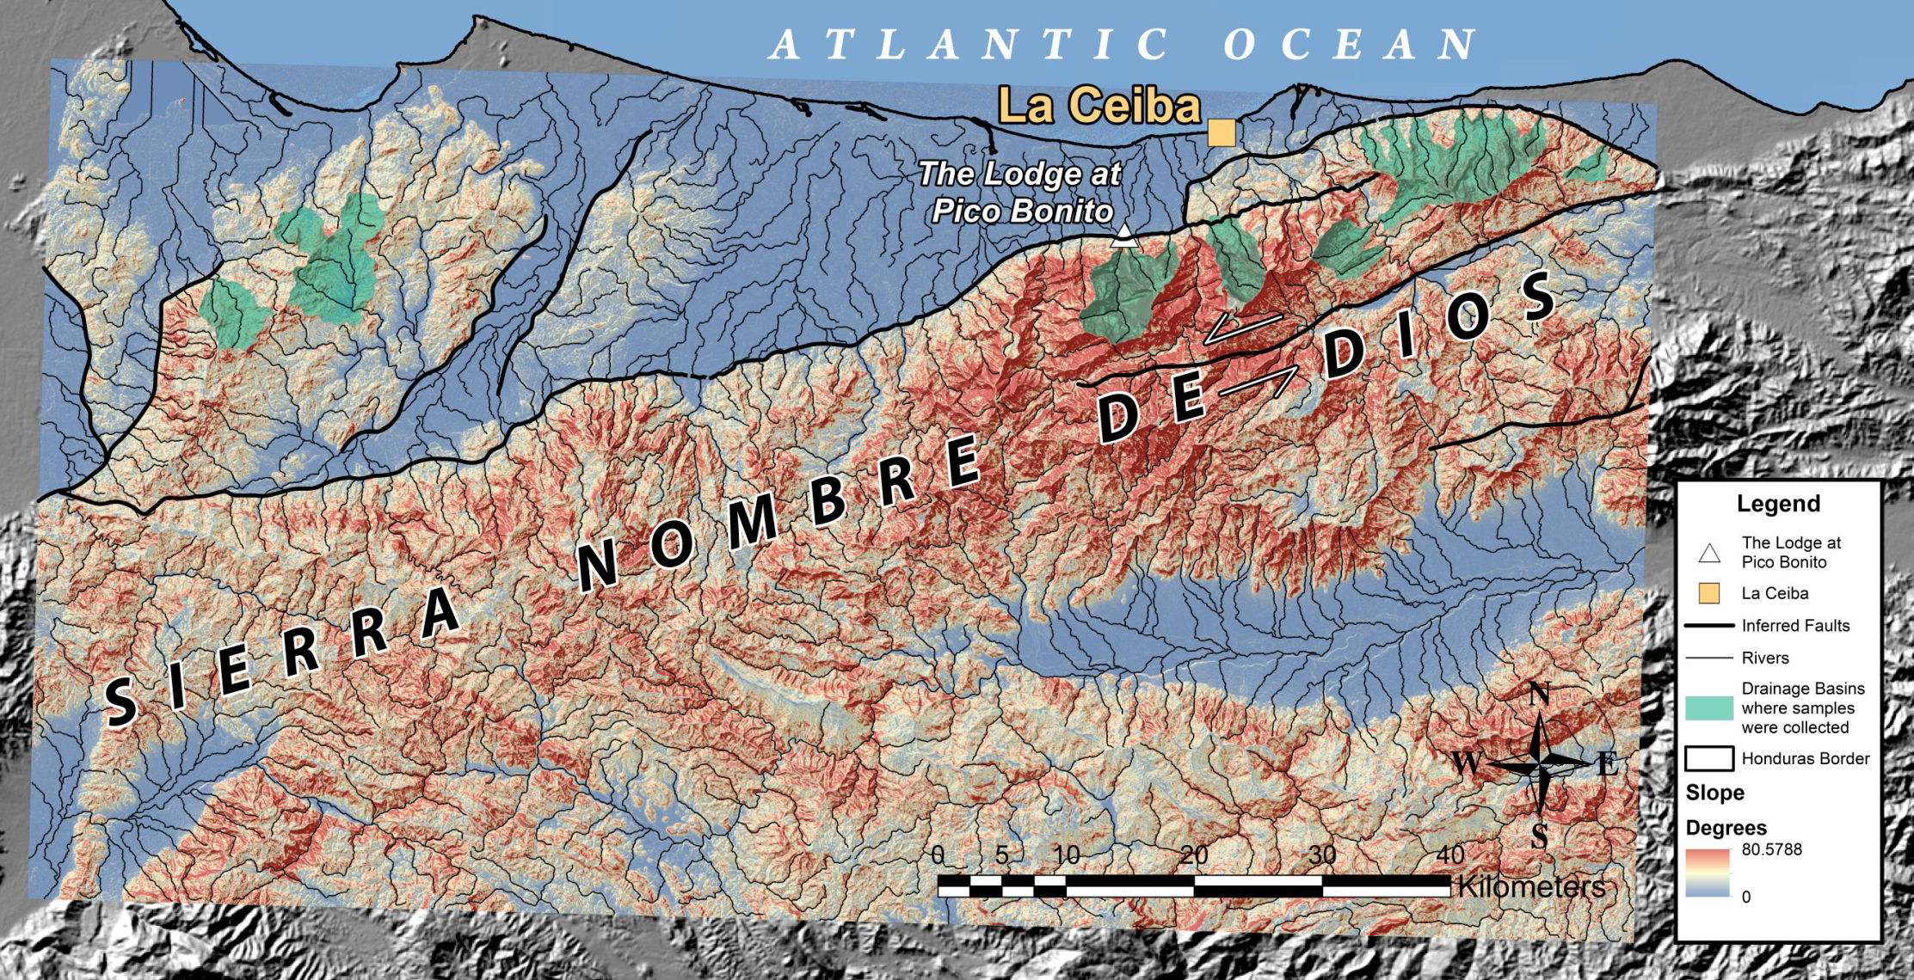
Nombre de Dios Mountain Range Slope Map
*Preliminary Map
Slope map of the Nombre de Dios Mountain Range. The steep slopes of the range in addition with the high rainfall on the northern mountain front mean a high risk of landslides. The Lodge at Pico Bonito itself sits on an active alluvial fan.

Slide 9
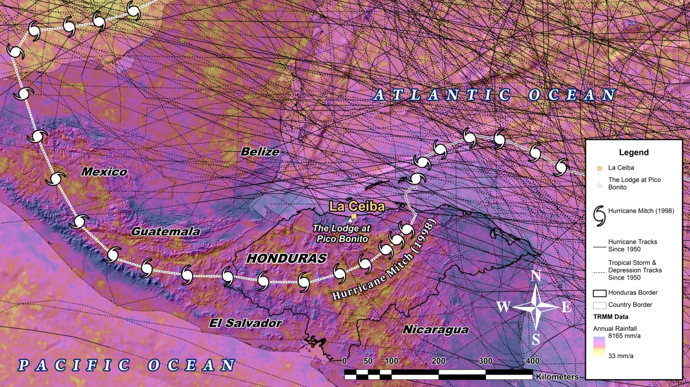
TRMM (Tropical Rainfall Measuring Mission) Data and Regional Hurricane Tracks Since 1950
*Preliminary Map
This map will illustrate the large amount of annual rainfall (in mm per year) in the northern Honduras along the northern Nombre de Dios mountain front. Imagery was derived from NASA/JAXA TRMM satellite data.
Hurricane tracks as well as Tropical Storm and Tropical Depression tracks since 1950 have been displayed to illustrate the hurricane risk of northern Honduras and the city of La Ceiba.

Slide 10
PROGRESS
Progress:
Satellite imagery was collected and mosaicked together in GIS software
Seismicity, hurricane track, TRMM, and DEM datasets have been collected
Preliminary maps have been constructed using GIS software

Slide 11
CONCLUSION
These educational maps will be used as a public outreach tool for locals and visitors that visit the Lodge at Pico Bonito in Honduras and will be used to inform people of the hazards of the region.
The map set will also provide information regarding the geology and geography of the La Ceiba/Sierra Nombre de Dios region in an effort to highlight the unique geologic setting of the area.

